Slide 1
AIML CHATBOT
Created by :
Akshay Pawar 12004
Shreyas Mahajan 12005

Slide 2
Overview
What is Chat Bot?
A chat bot is a conversational agent where a computer program is designed to simulate an intelligent conversation.
There are many open source platforms from where we can develop a chat bot. AIML is one of them.

Slide 3
Why a CHATBOT ?
To provide a memorable UI.
They provide us exact information which is requested by a user.
This system can be used by anybody and it can be used on websites , especially on product or service related websites.

Slide 4
Features
This bot can answer queries which passengers usually have while they are traveling by a particular airline.
Simple UI
User Interface that can be understand by toddler.
Provides a graphical representation of all user’s statistics to website owner.

Slide 5
Technologies Used
AIML(Artificial Intelligence Mark-up Language)
Python
Flask FrameWork
HTML/BOOTSTRAP
SQLITE3
Pycharm (IDE)

Slide 6
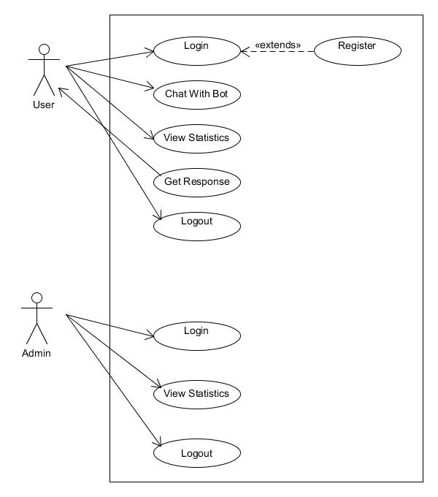
UML Diagrams: Use Case:

Slide 7
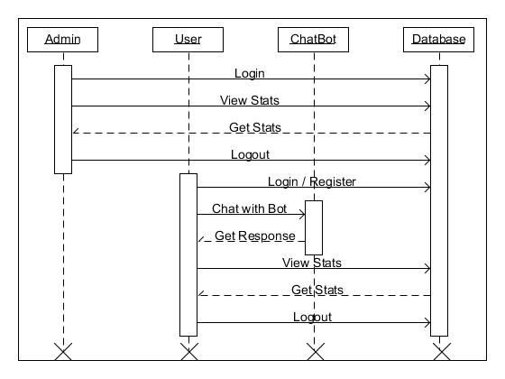
Sequence Diagram:

Slide 8
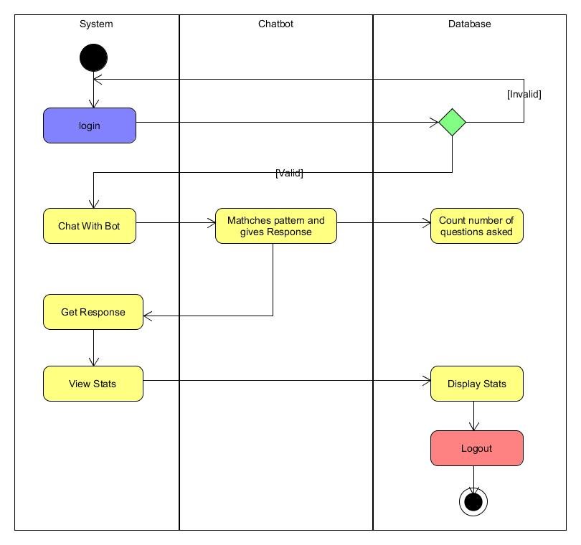
Activity Diagram: User:

Slide 9
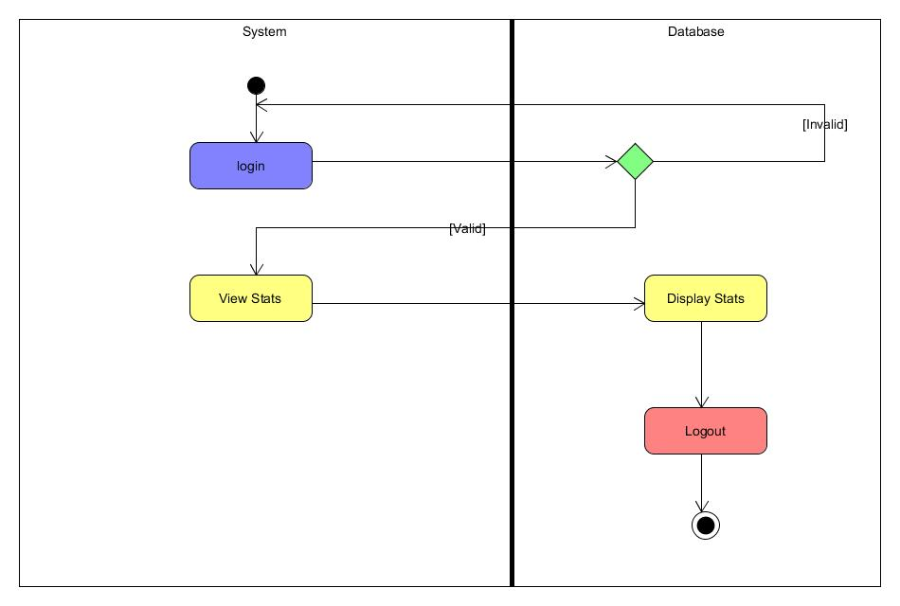
Activity Diagram: Admin:

Slide 10
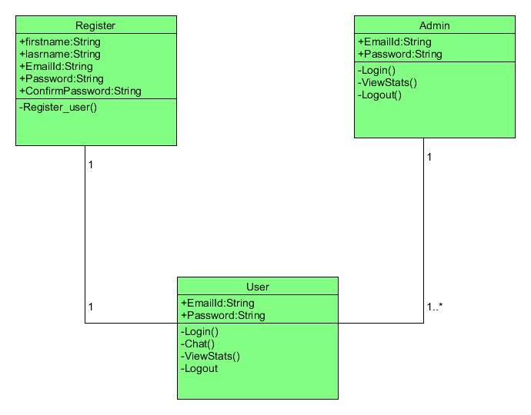
Class Diagram:

Slide 11
Drawbacks:
It is a scripted bot.
Future Enhancements:
We can implement some AI algorithms.
We can also consider giving input to our chat bot by voice.
We can further generate more efficient reports.

Slide 12
THANK YOU!

